Slide 1
Problem identification
What opportunities exist for Big Mountain Resort to increase profits by at least $1.5 million in the upcoming season?
Increase Profits in upcoming season
(+) Revenue
Increase ticket pricing in view of competitor pricing and new lift service
(-) Cost
Reduce costs by closing some runs and snow making area

Slide 2
Recommendation and key findings
(+) Revenue
1. Increase ticket prices by $1.99 per ticket from the current $81.00 per ticket
The additional lift and service offering by Big Mountain ranks high in the market and was projected to support an increase in revenue by $3.5 million this season.
Top four factors affecting ticket price:
Fast quads
Runs
Snow making area
Vertical drop
(-) Cost
2. Closing 2-3 runs will reduce OpEx, but will result in a reduction in revenue
Closing down 5 runs will have the same effect on revenue as closing 3 runs. Increasing the closures down to 6 or more leads to a large drop.
3. Increasing the snow making cover by 4 acres resulted in negligible difference in the revenue.

Slide 3
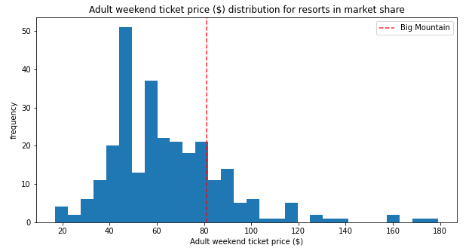
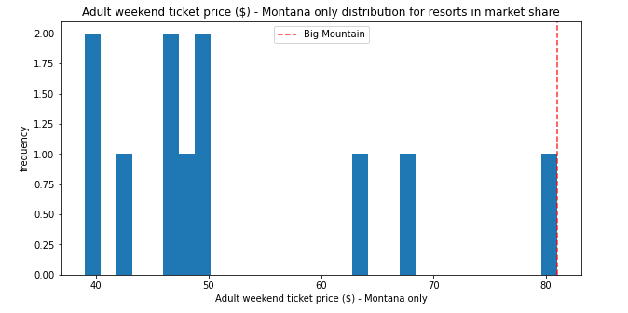
Modeling results and analysis
Big Mountain is priced at the average range of ticket prices for resorts in the market share.
However, as it is in the top-end of ticket prices in Montana, price elasticity of customers need to be taken into account.

Slide 4
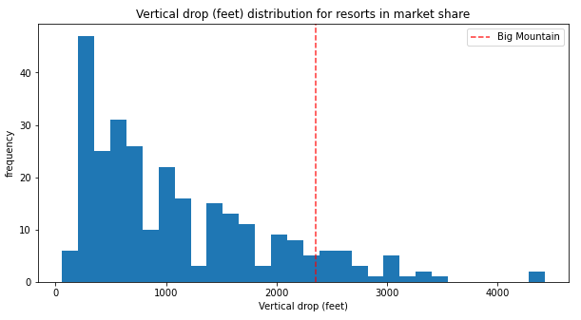
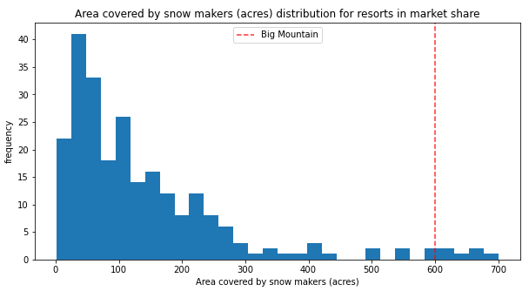
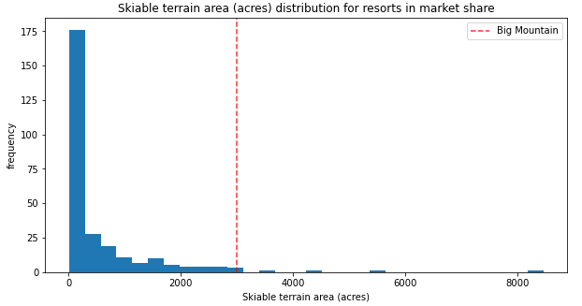
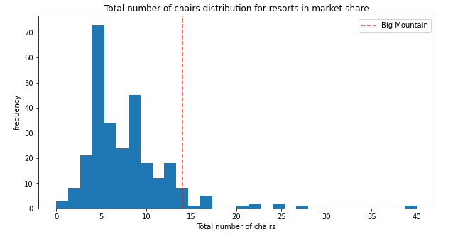
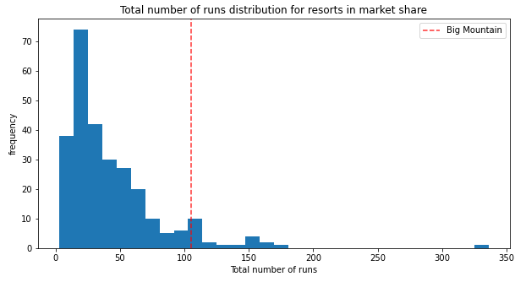
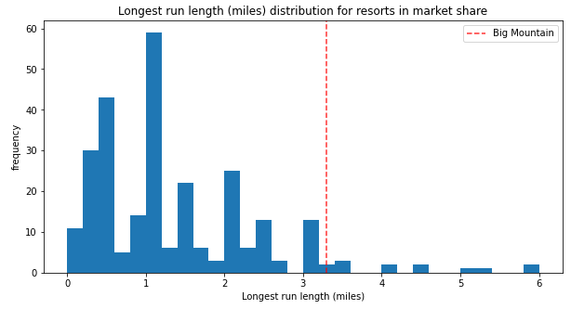
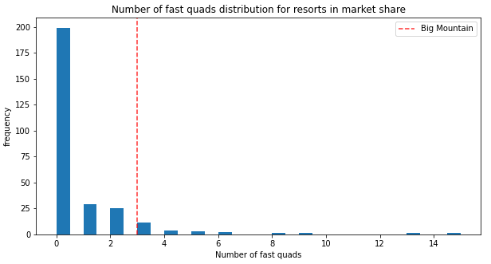
Modeling results and analysis
Within the market share, Big Mountain ranks highly for most key features affecting ticket price.
The vertical drop can be improved with the installation of the additional lift, supporting higher ticket prices.

Slide 5
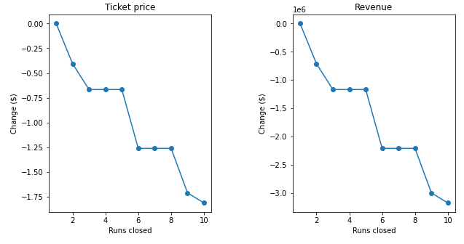
Modeling results and analysis
Closing 2-3 runs will reduce OpEx, but will result in a reduction in revenue
Based on the random forest regressor model, closing down 5 runs will have the same effect on revenue as closing 3 runs. Increasing the closures down to 6 or more leads to a large drop.

Slide 6
Summary and conclusion
What opportunities exist for Big Mountain Resort to increase profits by at least $1.5 million in the upcoming season?
(+) Revenue
Increasing ticket prices by $1.99 per ticket from the current $81.00 per ticket, was projected to support an increase in revenue by $3.5 million this season. This can cover the OpEx of the new lift of $1.5 million, generating additional profits of $2 million.
Further work
Night skiing scenarios and number of lifts can be further considered.
Some missing data in the average weekday prices, which limited our analysis to adult weekend prices.
Sensitivity analysis can be run with the model on different parameters and conditions to refine ticket price increase amount.

